Slide 1

Project Presentation – Netflix Insights
IST-707: Applied Machine Learning
Benjamin Dieck
Tim Tieng

Slide 2
Agenda
Business Problem (Problem Statement)
Company & Data Overview
Business Questions – Research Topics
Initial Exploratory Data Analysis
Questions

Slide 3
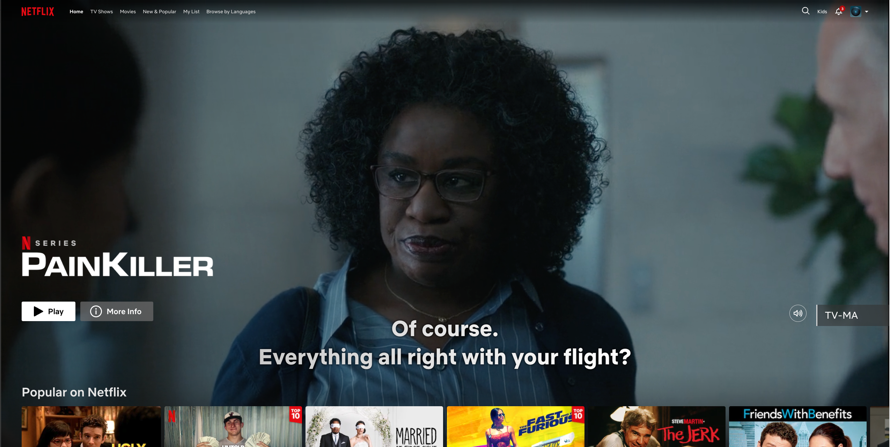
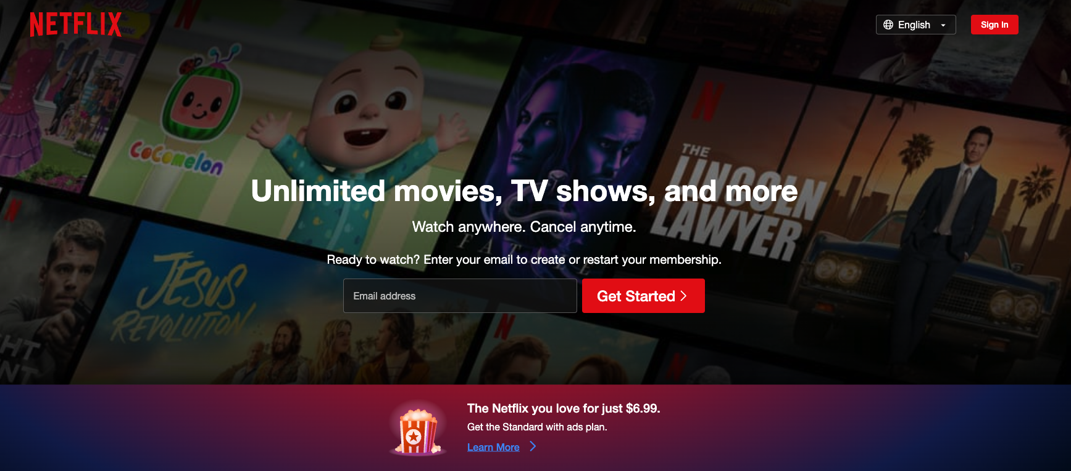
Company & Data Overview – Netflix and its Competitors
Netflix is one of the biggest streaming services in the world, and certainly the largest in the US. As of Q1 2023 they are accredited as having 44.21% market capture in a market that is over saturated with competitors including Disney, Hulu, Apple, and many of the fortune 500. Their nearest competitor, Hulu, boasts a 20.32% market capture in the same fiscal. While this may not account for overlapping traffic, each of the platforms market share is in decline with Netflix dropping 5.56% in market share from the same quarter in FY22. The same source marks the top three, Netflix, Hulu, and HBO Max, all meeting decline likely due to the influx of new entries / studios such as Peacock (Pandey, 2023).

Slide 4

Business Problem
Utilizing publicly available information provided by Kaggle, can a team of Data Scientists & Analysts effectively predict or determine anomalies that can help facilitate the decision-making processes of Netflix’s business operation organizations?
Desired Goals:
Generate more revenue through increased userbase
Expand market share in the streaming industry for Netflix by including audience-approved titles
Notes:
Tallking Points:
Understanding that Netflix is a for-profit business, it is important to note that the company, or any streaming company in general will adopt business practices that will generate the most revenue for the company
Return of investment

Slide 5
Company & Data Overview – Kaggle Datasets
Netflix Userbase Dataset
Description: The dataset provides a snapshot of a sample Netflix userbase, showcasing various aspects of user subscriptions, revenue, account details, and activity. Each row represents a unique user, identified by their User ID. The dataset includes information such as the user's subscription type (Basic, Standard, or Premium), the monthly revenue generated from their subscription, the date they joined Netflix (Join Date), the date of their last payment (Last Payment Date), and the country in which they are located.
Schema: 10x Attributes
2. Netflix audience behavior - UK movies
Description: The dataset covers user behaviour on Netflix from users in the UK to opted-in to have their anonymized browsing activity tracked. It only includes desktop and laptop activity (which Netflix estimate is around 25% of global traffic) and is for a fixed window of time (January 2017 to June 2019, inclusive). It documents each time someone in our tracked panel in the UK clicked on a Netflix.com/watch URL for a movie.
'Duration' shows how long it was (in seconds) until that user clicked on another URL. A watch time of zero seconds means they visited the page but instantly clicked away.
Schema – 8x Attributes of various datatypes

Slide 6
Total Attribute list
Transaction_id
Datetime
Program_id
Production country
Type of program
Year Category (Modern, Classic, 80’s, 90’s)
Title
Imdb Rating
Times it has been viewed
Imdb votes
Rotten tomato popularity by positive review
Rotten tomato score
Run time in seconds
Duration watched
Ratio run time / duration
Behavior classifier
Genre
Genre Simplified
Release date
Movie id
User transactions
User id

Slide 7
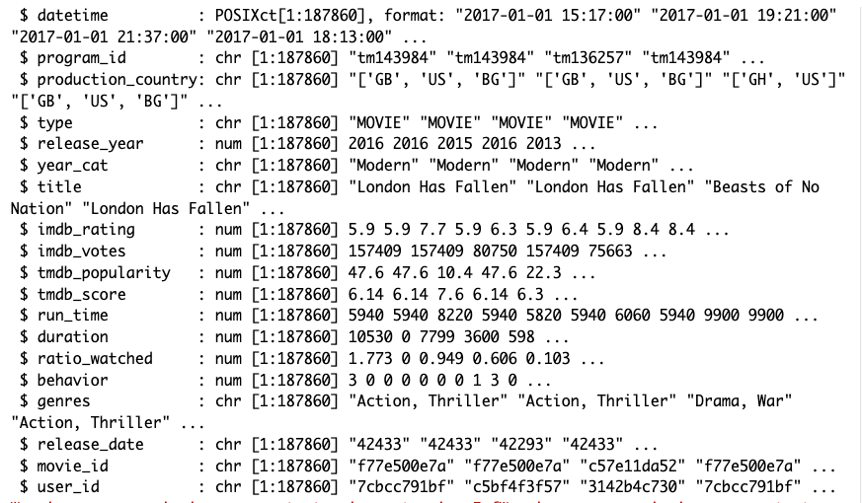
Company & Data Overview – Combining two different Datasets
Our combined data set has 20 attributes, and over 180,000 rows of data.
Data types: The prevalent datatypes we have in our data sets are either numerical or character datatypes
Conversion will be needed to aggregated data

Slide 8
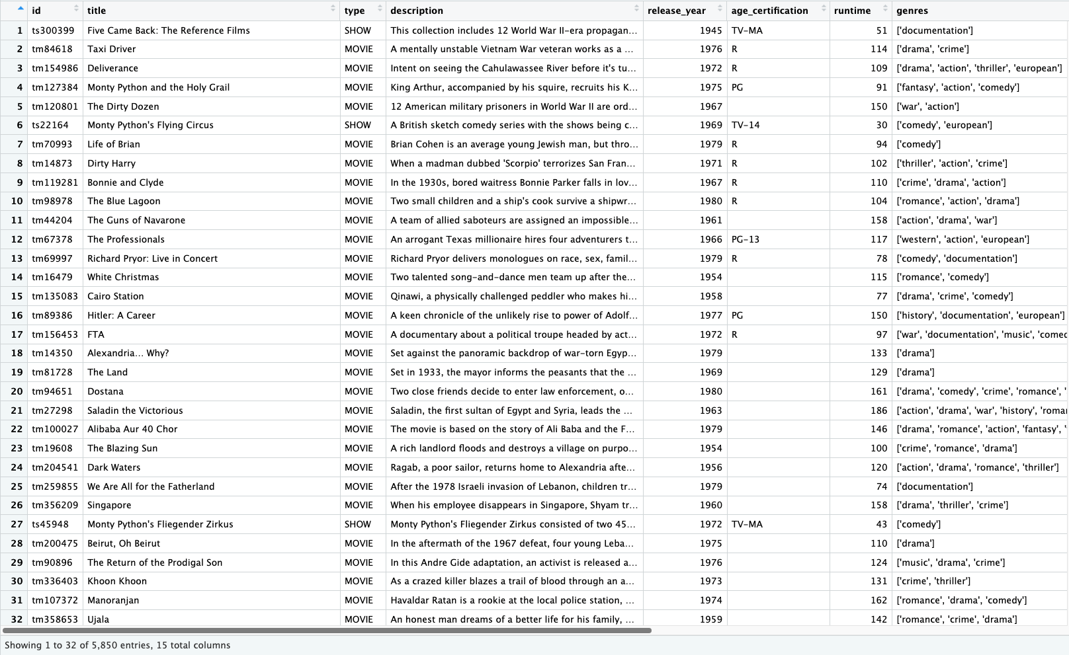
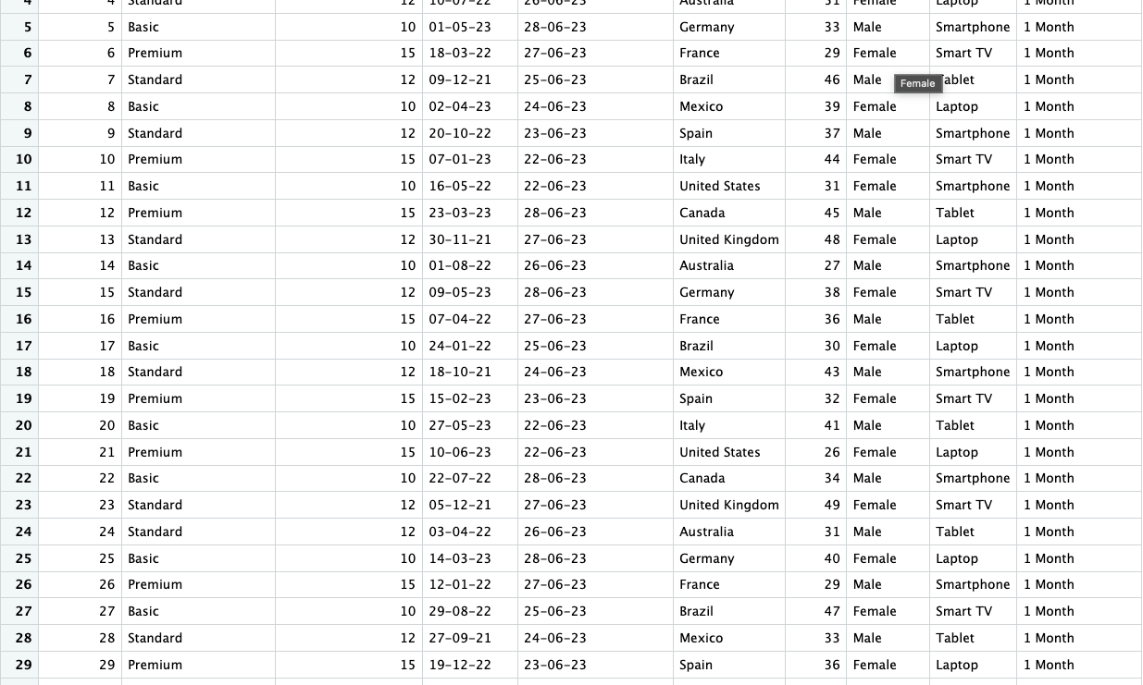
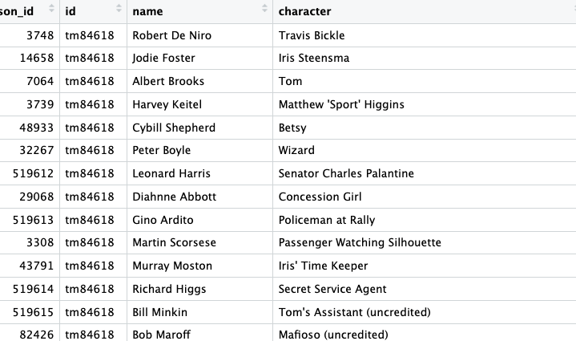
Company & Data Overview – Data Frame
Legend
Green Outline – Netflix Titles Data
Blue Outline – Netflix User Data
Black Outline – Netflix Credits Data
Notes:
This is a raw look at the individualized data files. To illuminate anomalies that can positively affect business operations of Netflix.
1 Key things to note for our team:
We recognized that not one datasource will be sufficient in providing the information needed to meet the desired goals outlined in the beginning of the presentation
We know will we have to combine multiple datasets and carefully select which attributes from each dataset will bring the most value
The risk we face is that the information may not be a 1-1 mapping between the datasets. In order to help combine the datasets, the team will use Excel VLOOKUP functions to help ensrue the data we pull in to create a usable dataframe brings over the correct data.
We will map to a specific titleI, and userId

Slide 9
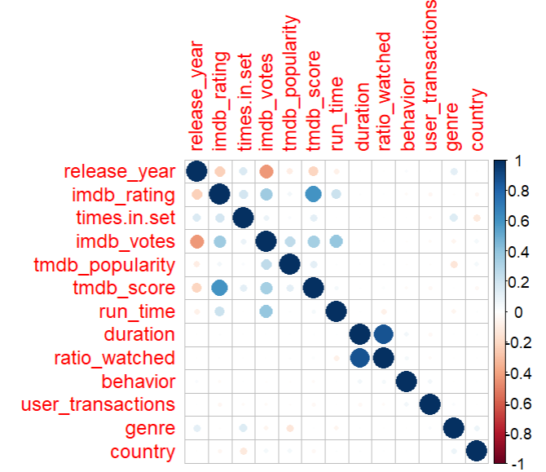
Correlation of attributes
No smoking gun that jumps out as invoking the behavior that we might like to encourage, binge watching shows.
Numerous correlations in voting, popularity, etc…
Notes:
The shading of the dot and size of the dot are relative to how strongly positive or negatively corrolated a value is.
The big takeaway on that one was that no single variable is useful in correlation to, this made someone watch the whole thing.

Slide 10
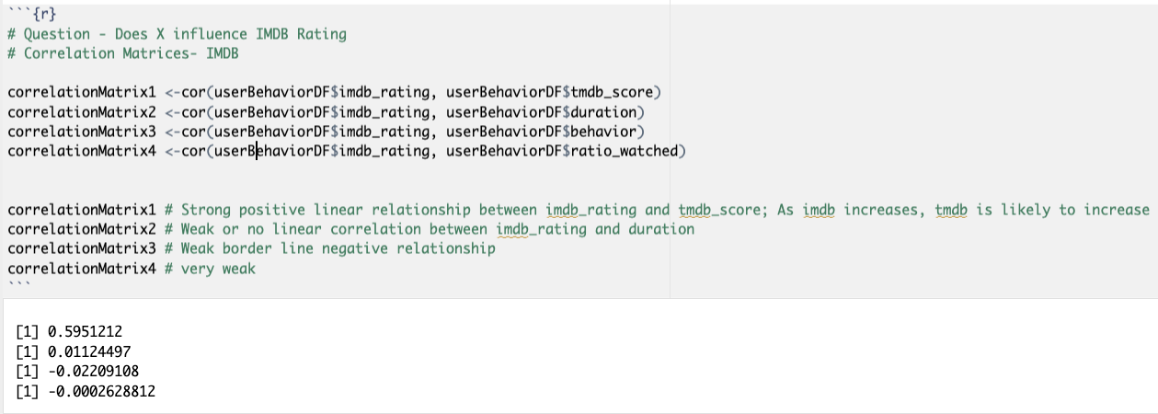
Initial Exploratory Data Analysis - Correlation
Significance – There may be data quality issues that was introduced by the way the team combined the data files into one dataframe.
Notes:
To help with our EDA, we wanted to see if there were any variables that could help provide insight in ratings

Slide 11
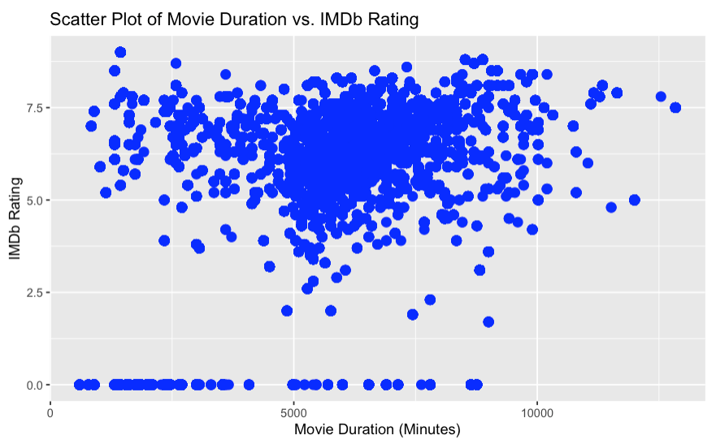
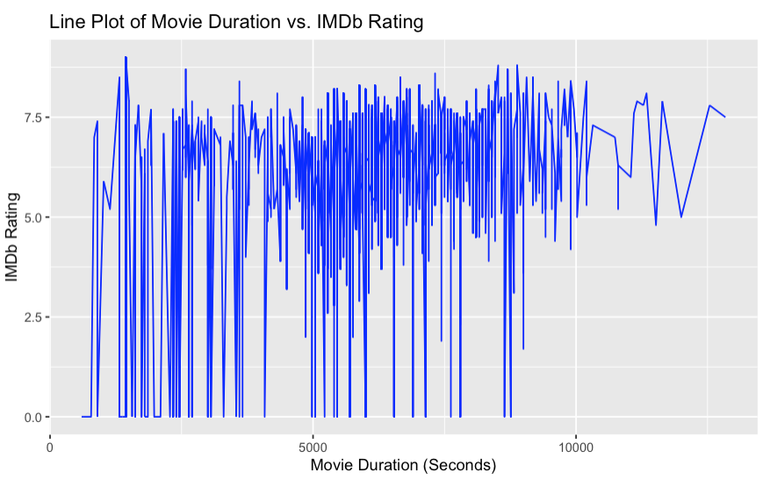
Bi-Variable Analysis – Movie Duration Vs IMDB Rating
Notes:
Talking Points
We wanted to take an initial look at what attributes would likely influence an IMDB Rating. This type off insight may indicate that there is a specific title that runs for a specific amount of time that may contribute to a higher IMDB rating. If Netflix is able to see which attributes positively influence
audience ratings, it may provide a business opportunity to have another department to handle the licensing aggreements to get titles onto the platform.
We assume that there is a combination of multiple attributes that will influence ratings, not just one. This is just our initial look

Slide 12
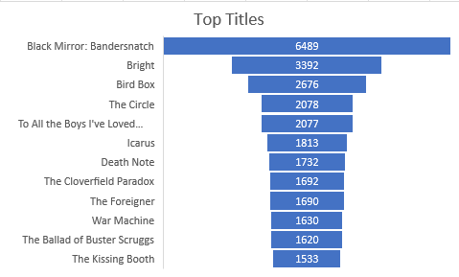
Initial Exploratory Data Analysis
Top 12 Programs within the UK
Average Rating by Titles

Slide 13
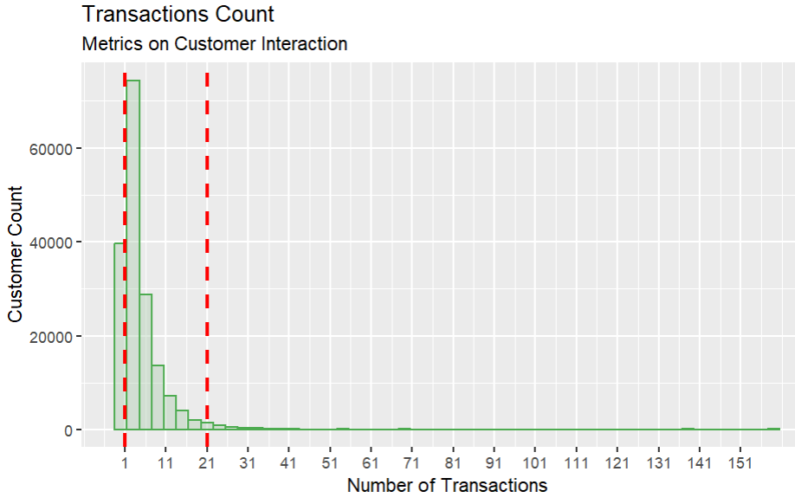
Majority of transactions
Tracked by user over the 3 year window
HDI, 95%, has less then 21 interactions represented in the set.
However we removed about 400k transactions from the set.
Might be worth going back to see what overall user behavior is

Slide 14
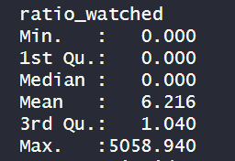
Initial Exploratory Data Analysis- Continued
Average Rotten Tomatoes Ratings
Compiled Metrics
Notes:
When compared to user data, and actual use cases of media, we were able to extract some degree of insight through aggregated metrics. One of the most promising came from the comparative analysis of run time of a given title, per session, to the next click generated by a user.
We utilized this information, transformed all times to seconds, and started to generate ratios of how much of a film users were actually watching. This lead us to start categorizing behaviors in how users were interacting with media. Of the over 187K transactions on UK Netflix services the bottom 50% of transactions were not even watched, they were skipped over.
It wasn’t until the 3rd Quartile of interactions that we started seeing users fully watch the program. The max end of the spectrum, where a user could watch 5000% of a program, were explainable behaviors where users clicked, and then forgot about the show. From a business standpoint, Netflix keeps market share by grabbing and holding onto attention. Where not only do you watch something, but you also binge watch something. You want to take up as much of people’s time as possible. That is how Netflix keeps and grabs market share. And it is decided by content.

Slide 15
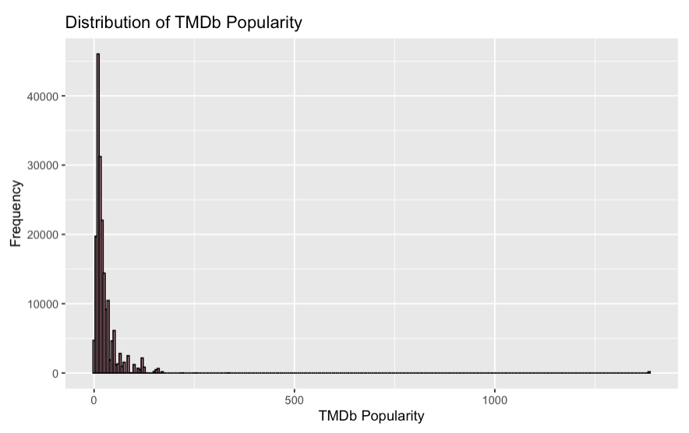
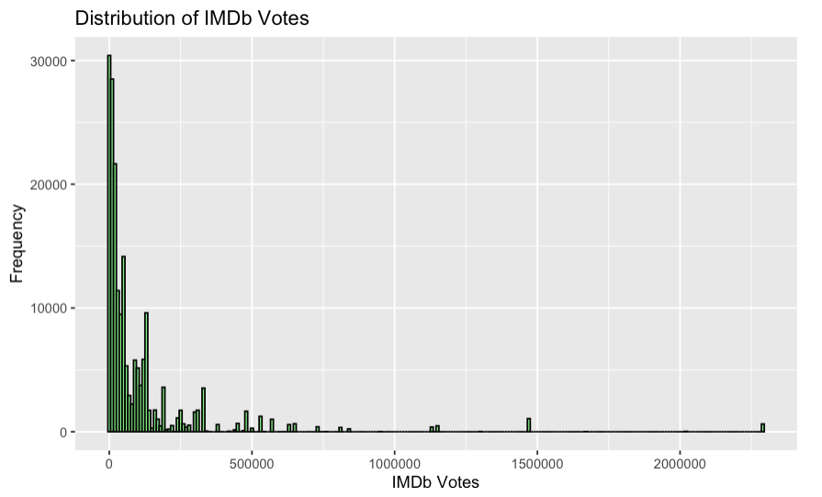
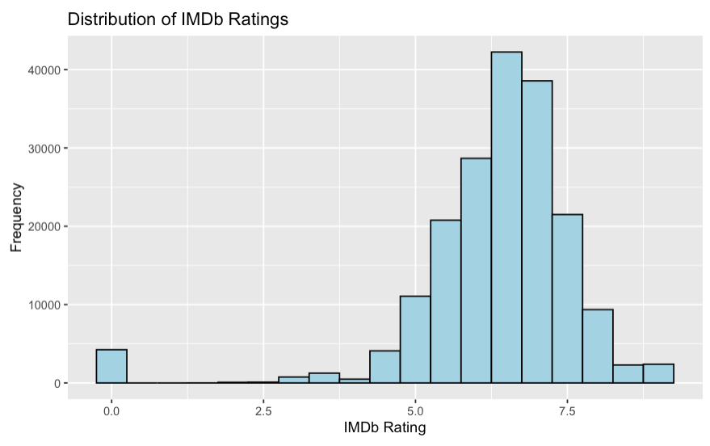
Initial Exploratory Data Analysis - Continued
Significance: Initial look of the distribution of numerical attributes in the dataset. This will help us understand how the data is arrayed in its current form

Slide 16
Business Questions – Research Topics
What is the key leading indicator / metric of capturing a viewer’s attention:
What are most of our viewer base there to watch?
Are we getting more return out of new releases and mega titles (that are likely more expensive to license) or is our viewer base more interested in B List / Classic Content from archival footage?
Of intellectual property, what should we be getting more of, and what can we stop paying for?
Does the existence of one actor, or another, play a part in movie choice? Can we determine who is top entertainers by user activity?
Can we, formulaically, determine a method to jump start a given actors career based on the power of the algorithm?
Can we accurately predict Netflix’s recommendation algorithm for users not within the data set?
Notes:
1. What is the combination of content clues that takes content and maximizes why a viewer is watching it? This becomes a factoring question and can be modeled using transactional data.
2 . And what we know now is that it isn’t just clicking on it, but actually digesting the media.
3., We have also been able to get significant actor data, and descriptions of film synopsis. Of these, we were able to break them down, atomically, into single words.

Slide 17
Questions?
Notes:
Talking Points
This is our project so far. We understand that we have some more work to be done in order to meet our desired endstate
Data Cleaning
Understanding relationships between attributes
Selecting the appropriate model/Models & techniques to provide concrete business justification to pursue a course of action.

